Slide 1
Alexia’s Internship Experience
May - August 2025
Manager: Robert Clark

Slide 2

Alexia Wells
Business Intelligence Intern
Bachelor’s degree in Statistics: Data Science from BYU
Master’s degree in Business Analytics from University of Utah

Slide 3

What is Business Intelligence?
Business intelligence analysts transform raw data into meaningful insights that drive strategic decision-making within an organization.

Slide 4
What Types of Requests Come In?
3
1
2
Reports
Create a new report via Report Builder or SQL
Update an existing report
Copy a report
Can you check the filters on these reports?
Dashboards
Create a new dashboard
Update an existing dashboard
Results on the dashboard aren’t matching, can you figure out why that is?
ROFEs
(Read Only Form Elements)
Create a new ROFE
Update an existing ROFE

Slide 5

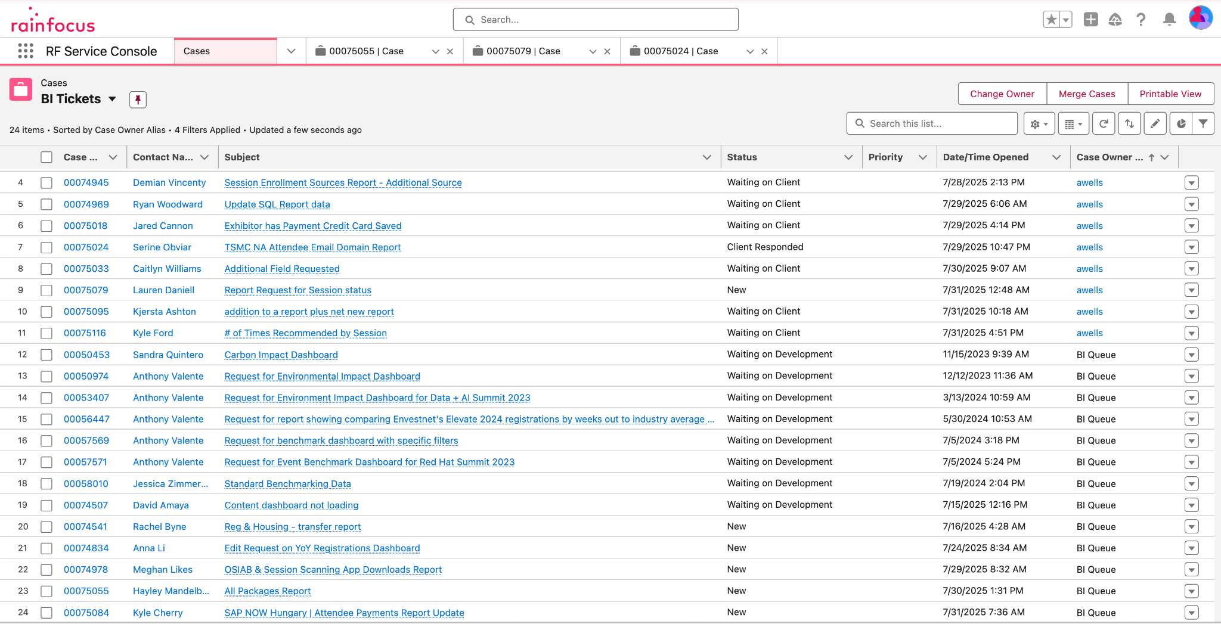
Typical Workday

Slide 6
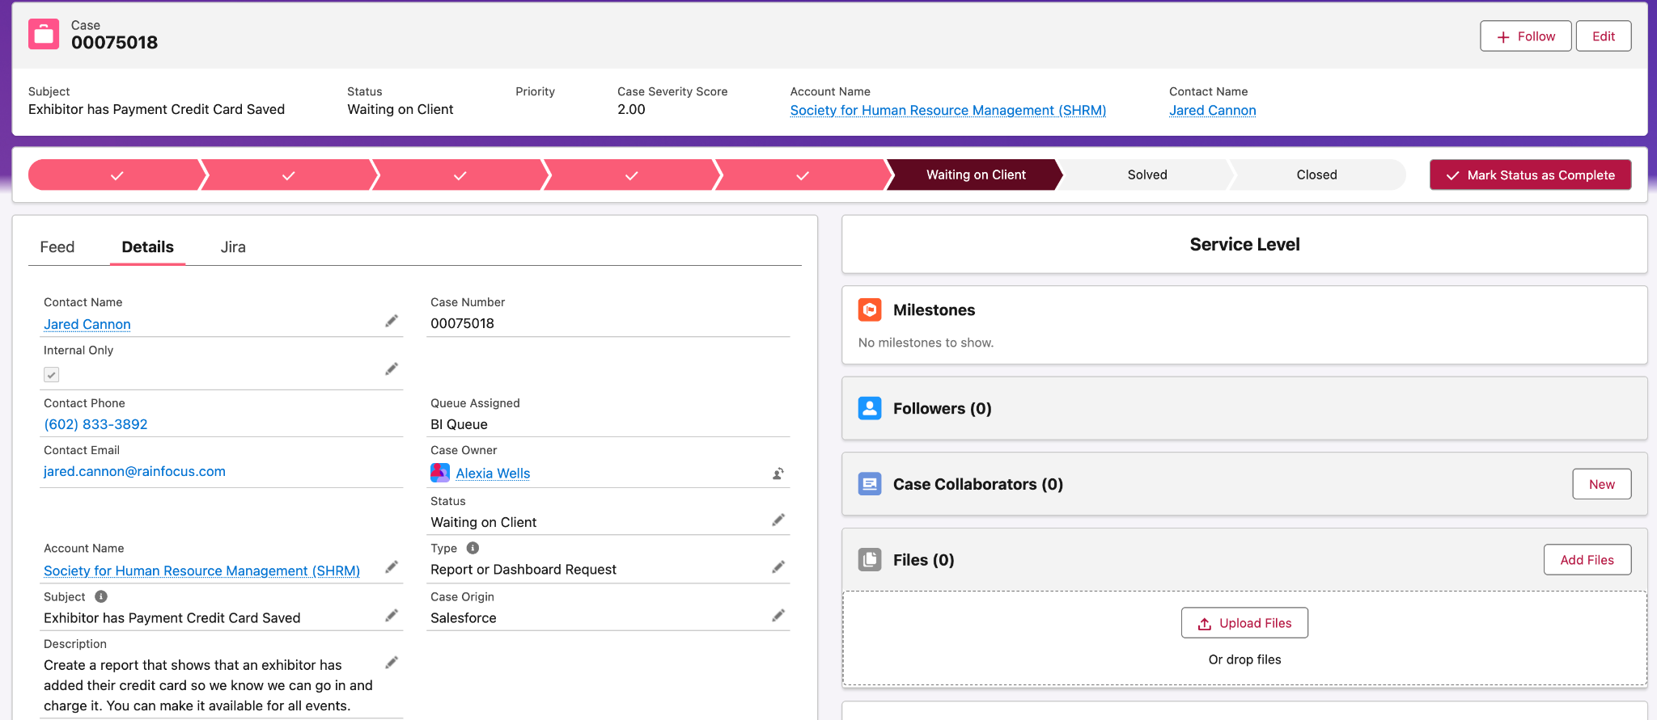
Typical Workday

Slide 7
There are 570 tables in the database, the BI team doesn’t use all of them…
Table Info

Slide 8
Tickets Closed Per Month
June: 25
July: 31

Slide 9
Teamwork in the Workplace
Daily Team Syncs
Communication/Collaboration via Slack
Knowing which tables to work with in the database
Help joining tables
Checking thought process/work
Clean Code

Slide 10
Key Takeaways
A good analyst can help a client form a data story that they are trying to tell
Anticipate questions that may be asked about the data we provide

Slide 11
Thank you

